Slide 1
2024-2025 FTC Kickoff
September 7th, 2024

Slide 2
Welcome Back
Dakota Region has been allocated 2 teams for the Championships
Houston, Texas | April 16th – April 19th
3 Qualifiers (Minot, Fargo, Bismarck)
Events limited to 20 teams
Teams allowed to pick 2 of the 3 they wish to compete in

Slide 3
Learning Dates
September 7th
Kick Off Bismarck Career Academy
October 12th
Marketing, Community Impact, Engineering
November 16th
Team Presentations, Programming, Head Ref Q&A
December 7th
Scrimmages, 10am-4pm | Fargo ND & Eastern ND (TBD)

Slide 4
Competition Dates
January 18th
Minot Qualifier – Bishop Ryan High School
January 25th
Fargo Qualifier – NDSU Bentson Bunker Fieldhouse
February 1st
Bismarck Qualifier – Bismark Career Academy
February 15th
State Tournament – Bismarck Career Academy

Slide 5
Updates / Changes
In-Season Rule Updates
Updates/Clarifications written in Competition Manual and released every 2 weeks as applicable
Team Updates will be posted to our website and will highlight any changes to the Competition Manual
Sign up for Team Updates email notifications
Autonomous Period is now AUTO
Driver Controlled Period is now TELOP
Double Elimination Playoffs
Super Regionals…

Slide 6
Championship Costs
FIRST Increased the Championship Registration Fee
$2500/team (previously $2k)
Championship Housing should be booked through FIRST

Slide 7
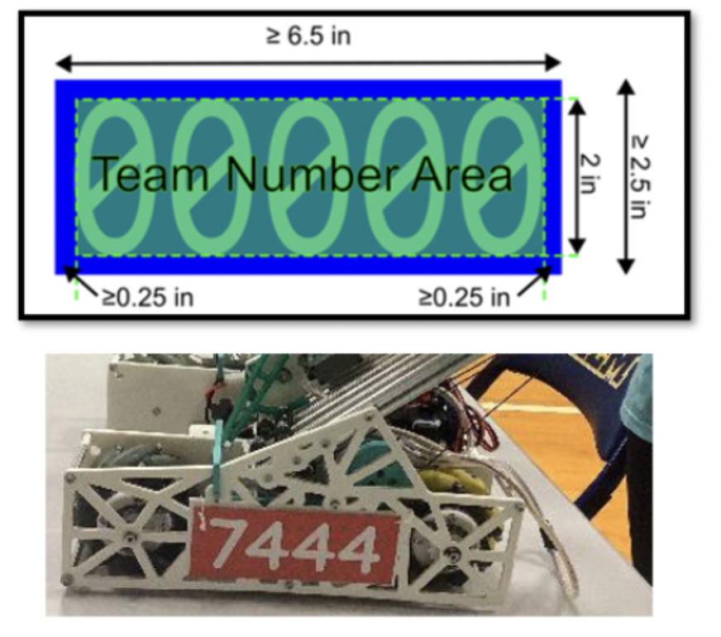
Robot Rules – Team Signs
Reduce complexity of rules around team numbers and Alliance Markers
Eliminates advantage of short team numbers and skinny fonts
Alliance Identification is easier for referees, scorers, etc.

Slide 8
Robot Rules
More legal electronics options
Servo Power Limit - almost all servos previously being used are still legal
Software Minimum Versions – Recommended not required
Quick Reference Update – Legal and illegal parts lists

Slide 9
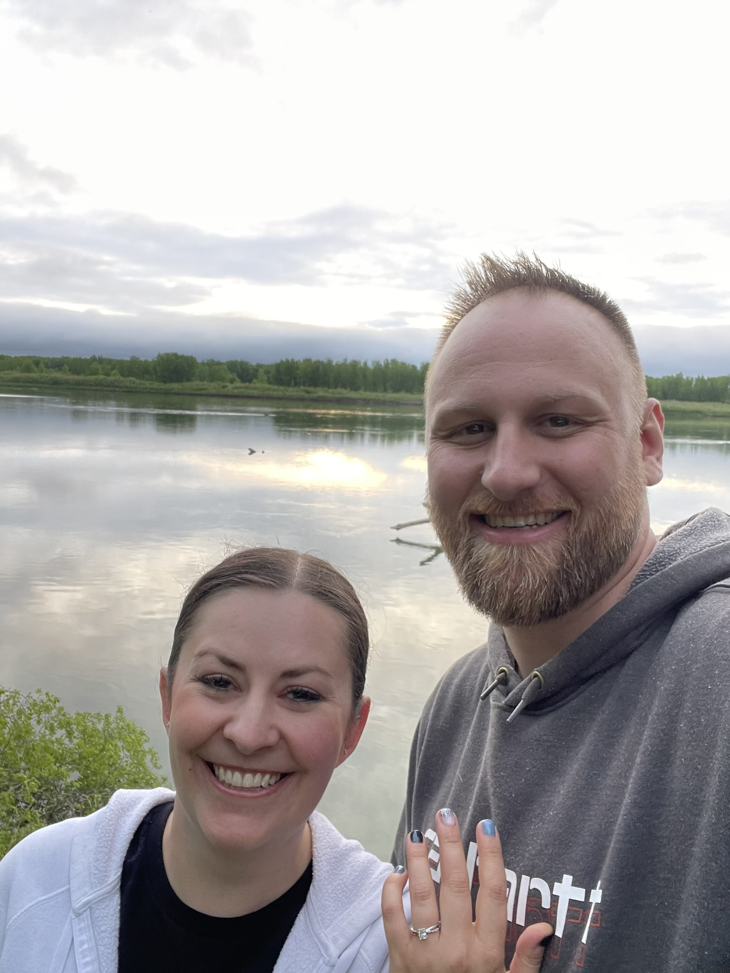
Portfolios, Interviews, & more
Rev. Jason legatt
Stockholm Syndrome Works

Slide 10
Portfolios
Yes, you are still expected to turn in a portfolio at the competitions
Last year I asked you all to step up the quality of portfolios submitted
The Good News
Congrats! You Did It!!
You all made the judges job A LOT Harder.
Portfolios have gotten exponentially better.
The Bad News
The bar has been raised for everyone.
A good portfolio has the same meaning now as saying “It was good…” when asked about a restaurant’s food.
What are you going to do to distinguish yourself from everyone else?

Slide 11
Award News
Portfolios are no longer required to win awards
How are you going to make the judges remember what you did? Maybe turn in a fun little pamphlet of sorts thats nicely organized…?
Control award submissions now are part of the Portfolio.
Less work for you
Promote award will no longer be given out
Next Learning Day I will break everything down further.

Slide 12
Award News
State Qualifiers
Will be online interviews the week of Qualifiers
Usually Monday or Tuesday afterschool.
Exceptions only for extenuating circumstances
State Tournament
Will be IN PERSON
Morning of competition, starting ~ 8:40am, verified closer to competition

Slide 13
Call for judges
As usual we are looking for Judges. There’s like 5 reason to do it:
Fun thing for couples to do together.
Gain a superior sense of self as you have done something society deems “good hearted”
Free Shirt/Hoodie
Teams will give you free stuff
Do you still have contact information for your past students? Can you send out an email blast to them?
If interested have them contact me: jasonlegatt@gmail.com
Requirements:
At least 18 years of age (21+ Preferred)
High School Graduate
Pass a background check.

Slide 14
You’re in kahoots
What do you know about FTC?

Slide 15
Game Annoucement

